Slide 1
Tests, Macros, Unsafe
Course: Rust Basics
Author: Aleksandr Kugushev

Slide 2
Homework
for VS map
let mut handlers = Vec::with_capacity(count);

Slide 3
Tests
E2E
Integration
Unit

Slide 4
Why should we need to test only public API?
mod my_module { pub fn public_api(){ private_api(); } fn private_api(){ } }
Benefits of autotests
Regression
… that’s all folks!

Slide 5
Unit Tests in Rust
- my_module.rs
pub fn summ(left: i32, right: i32) -> i32 { left + right }
#[cfg(test)] mod tests{
use crate::my_module::summ;
#[test] fn summ_trivial(){
let result = summ(1, 2); assert_eq!(3, result)
} }
> cargo test
running 1 test
test my_module::tests::summ_trivial ... ok
test result: ok. 1 passed; 0 failed; 0 ignored; 0 measured; 0 filtered out; finished in 0.00s

Slide 6
Check panic
pub fn panic_on_42(num: i32) { if num == 42 { panic!("AAA!") } }
#[cfg(test)] mod tests { use crate::my_module::*; #[test] #[should_panic] fn panic_on_42_check_panic() { panic_on_42(42); } }

Slide 7
Result in tests
pub fn error_on_42(num: i32) -> Result<i32, String> { if num == 42 { Err(String::from("AAA!")) } else { Ok(num) } }
#[cfg(test)] mod tests { use crate::my_module::*; #[test] fn error_on_42_valid_cases() -> Result<(), String> { error_on_42(41)?; error_on_42(43)?; Ok(()) } }

Slide 8
Integration tests
├── Cargo.lock
├── Cargo.toml
├── src
│ └── lib.rs
└── tests
└── integration_test.rs

Slide 9
Integration tests for Console Apps
├── Cargo.lock
├── Cargo.toml
├── src
│ └── lib.rs
│ └── main.rs
└── tests
└── integration_test.rs
- Cargo.toml
[[bin]] name = "my_app" path = "src/main.rs" [lib] name = "my_app" path = "src/lib.rs"

Slide 10
How to test println!(“…")?
lib.rs
pub fn run(stdout: &mut dyn Write){ ... writeln!(stdout, "Hello"); ... }
main.rs
run(&mut io::stdout())
test.rs
let mut buffer: Vec<u8> = Vec::new(); run(&mut buffer); let actual = String::from_utf8(buffer).unwrap();

Slide 11
Macros
Code
Generated
let vector = vec![1, 2, 3];
let vector = { let mut temp_vec = Vec::new(); temp_vec.push(1); temp_vec.push(2); temp_vec.push(3); temp_vec };

Slide 12
Macros kinds
Function-like
Attribute-like
Custom derive, e.g. [#derive(MyCustomTrait)]
Compiler Macros
Procedural Macros
Macros by Example

Slide 13
Compiler macros
env!()
line!()
column!()
file!()
stringify!()
…

Slide 14
Procedural Macros
Exported function from crate with the proc-macro crate type
[lib]
proc-macro = true
Function-like
#[proc_macro] pub fn my_proc_macro(input: TokenStream) -> TokenStream { TokenStream::new() }
Attribute-like
#[proc_macro_attribute] pub fn my_attribute(input: TokenStream, annotated_item: TokenStream) -> TokenStream { TokenStream::new() }
Custom derive
#[proc_macro_derive(MyDerive)] pub fn my_derive(annotated_item: TokenStream) -> TokenStream { TokenStream::new() }

Slide 15
Macro by Example
Can be used in your crate
Function-like only
print!()
Declarative
macro_rules! print { ($($arg:tt)*) => {{ $crate::io::_print($crate::format_args!($($arg)*)); }}; }

Slide 16
Token Tree
a + b + (c + d[0]) + e
«a» «+» «b» «+» «( )» «+» «e»
╭────────┴──────────╮
«c» «+» «d» «[ ]»
╭─┴─╮
«0»

Slide 17
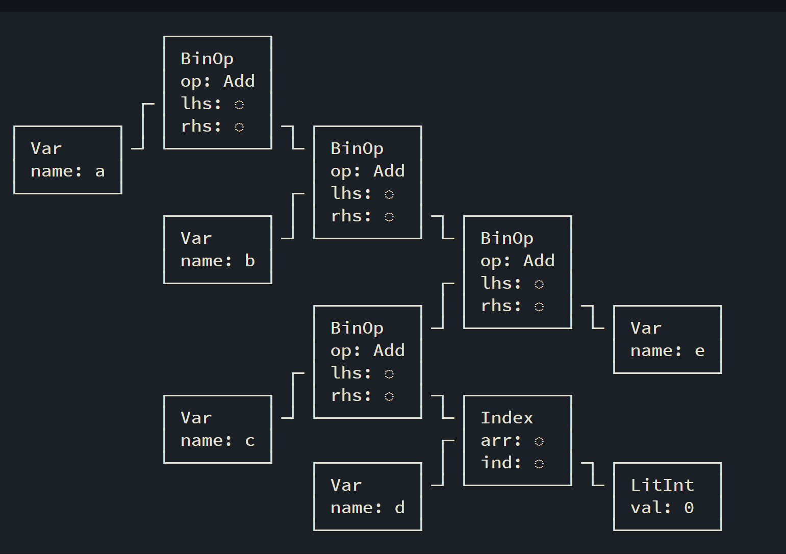
AST
a + b + (c + d[0]) + e

Slide 18
Macros in AST
bitflags! { struct Color: u8 { const RED = 0b0001, const GREEN = 0b0010, } } lazy_static! { static ref FIB_100: u32 = { fib(100) }; } fn main() { use Color::*; let colors = vec![RED, GREEN, BLUE]; println!("Hello, World!"); }
bitflags! ⬚
lazy_static! ⬚
fn main() { use Color::*; let colors = vec! ⬚; println! ⬚; }

Slide 19
Practice
let pif: i32 = square_summ!(1,2,3); println!("{pif}"); // 14
let pif: i32 = square_summ!(nothing); println!("{pif}"); // 0
let pif: String = square_summ!("I can't"); println!("{}", pif); // Error: I can't
macro_rules! square_summ { (nothing) => { 0 }; ($l:literal) => { format!("Error: {}", $l) }; ($($e:expr),*) => { { let mut summ = 0; $( summ += $e * $e; )* summ } }; }

Slide 20
Macro by Example syntax
macro_rules! $name {
$rule0 ;
$rule1 ;
// …
$ruleN ;
}
rule: ($matcher) => {$expansion}

Slide 21
Match
macro_rules! simple_macro {
(something) => { "something" };
() => { 42 };
}
let str: &str = simple_macro!(something); // "something"
let int: i32 = simple_macro!(); // 42

Slide 22
Metavariables
macro_rules! simple_macro { (something) => { "something" }; ($e:expr) => ( $e + 1 ); () => { 42 }; }
let int: i32 = simple_macro!( summ(2, 3) ); // 6

Slide 23
Metavariables are syntax tokens types
simple_macro!( "42" );
error[E0369]: cannot add `{integer}` to `&str`
($expr:expr) => ( $expr + 1 );
^ - {integer}

Slide 24
Metavariables
block: a block (i.e. a block of statements and/or an expression, surrounded by braces)
expr: an expression
ident: an identifier (this includes keywords)
item: an item, like a function, struct, module, impl, etc.
lifetime: a lifetime (e.g. 'foo, 'static, ...)
literal: a literal (e.g. "Hello World!", 3.14, '🦀', ...)
meta: a meta item; the things that go inside the #[...] and #![...] attributes
pat: a pattern
path: a path (e.g. foo, ::std::mem::replace, transmute::<_, int>, …)
stmt: a statement
tt: a single token tree
ty: a type
vis: a possible empty visibility qualifier (e.g. pub, pub(in crate), ...)
https://veykril.github.io/tlborm/decl-macros/minutiae/fragment-specifiers.html

Slide 25
Repetitions
$ ( ... ) sep rep
( ... ) is the paren-grouped matcher being repeated.
sep is an optional separator token. It may not be a delimiter or one of the repetition operators. Common examples are , and ;.
rep is the required repeat operator. Currently, this can be:
?: indicating at most one repetition
*: indicating zero or more repetitions
+: indicating one or more repetitions

Slide 26
simple_macro!("One" "Two" "Three");
macro_rules! simple_macro { (something) => { "something" }; ($($l:literal)+) => { { let mut out = String::new(); $(out.push_str($l);)* out } }; ($expr:expr) => ( $expr + 1 ); () => { 42 }; }

Slide 27
Visibility
Before your code
Use #[macro_export]

Slide 28
Hygiene
Local variables are sanitized
Functions are not sanitized
Crate is not sanitized
$crate workaround

Slide 29
$crate
Crate: helper_macro
Crate: binary
#[macro_export] macro_rules! helped { () => { $crate::helper!() } } #[macro_export] macro_rules! helper { () => { () } }
use helper_macro::helped; fn main() { helped!(); }

Slide 30
Unsafe
pub const fn split_at_mut(&mut self, mid: usize) -> (&mut [T], &mut [T]) { assert!(mid <= self.len()); // SAFETY: `[ptr; mid]` and `[mid; len]` are inside `self`, which // fulfills the requirements of `from_raw_parts_mut`. unsafe { self.split_at_mut_unchecked(mid) } }

Slide 31
Unsafe Superpowers
Dereference a raw pointer
Call an unsafe function or method
Access or modify a mutable static variable
Implement an unsafe trait
Access fields of unions

Slide 32
Dereference a raw pointer
let mut int = 42;
let ptr: *const i32 = &int;
let mut_ptr: *mut i32 = &mut int;
unsafe { *mut_ptr = 123; }
let int_ref = unsafe { *ptr };
println!("{int_ref}")

Slide 33
Call an unsafe function or method
pub const fn split_at_mut(&mut self, mid: usize) -> (&mut [T], &mut [T]) { assert!(mid <= self.len()); // SAFETY: `[ptr; mid]` and `[mid; len]` are inside `self`, which // fulfills the requirements of `from_raw_parts_mut`. unsafe { self.split_at_mut_unchecked(mid) } }
pub const unsafe fn split_at_mut_unchecked(&mut self, mid: usize) -> (&mut [T], &mut [T]) {…..

Slide 34
Access or modify a mutable static variable
Don’t do it, use Atomics ☺

Slide 35
Implement an unsafe trait
Unsafe trait is safe for users!
A trait is unsafe when at least one of its methods has some invariant that the compiler can’t verify.
pub unsafe auto trait Send { // empty. }

Slide 36
Access fields of unions
#[repr(C)] union MyUnion { f1: u32, f2: f32, }

Slide 37
Rust considers it "safe" to:
Deadlock
Have a race condition
Leak memory
Fail to call destructors
Overflow integers
Abort the program
Delete the production database

